Slide 1
MicroResist - The influence of snail host microbiome in trematode parasite resistance
PhD student: Ruben Schols
Promotor: Prof. Ellen Decaestecker
Co-Promotor: Dr. Tine Huyse

Slide 2
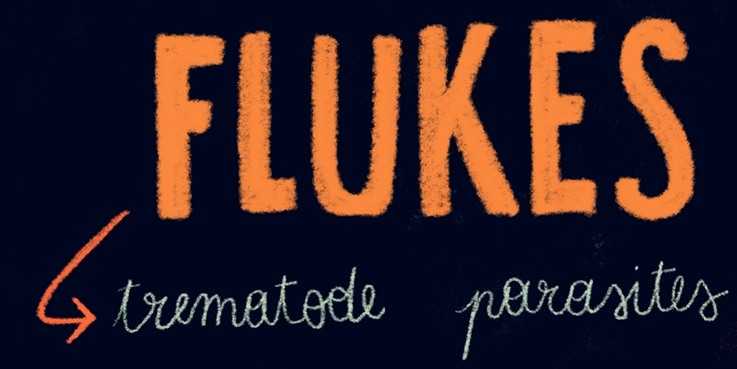
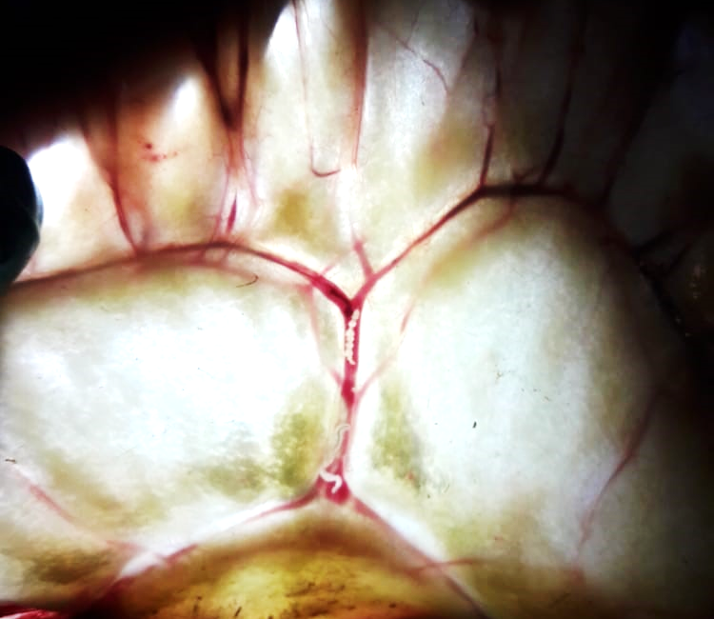
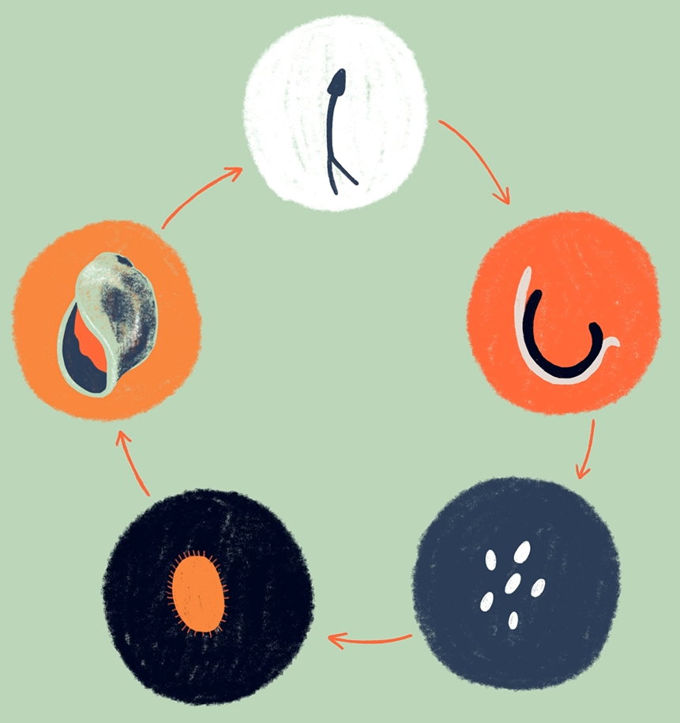

Slide 3
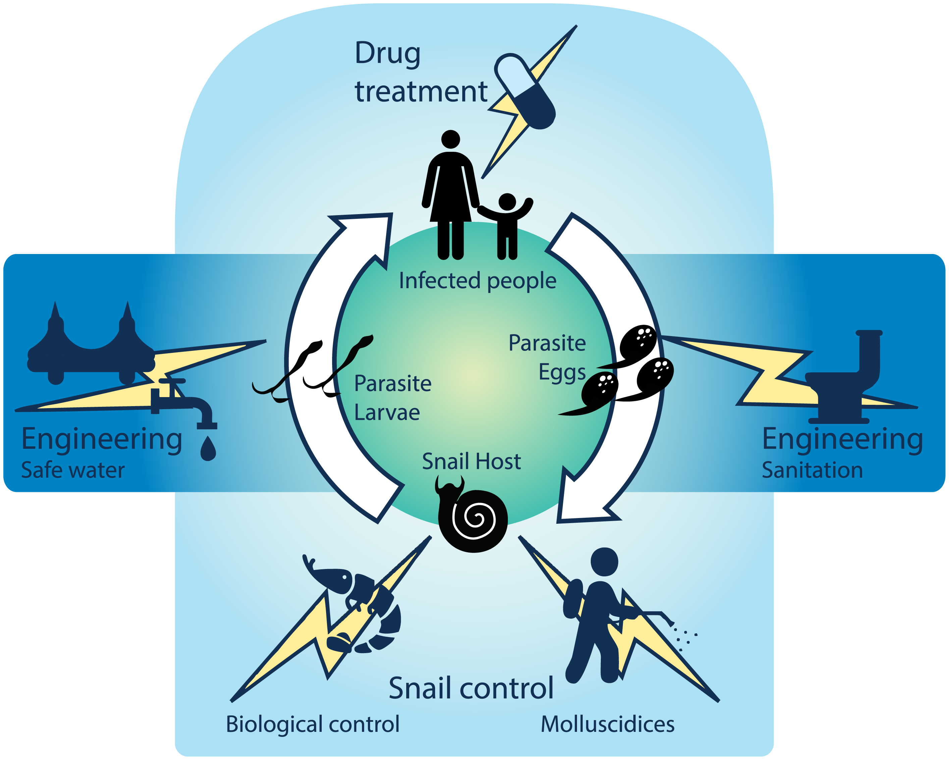
Introduction to MicroResist
Control measures
Limited success
Not sustainable
GOAL: Microbial solution
(cfr. malaria)
Sokolow et al., 2016
Icons made by <a href="https://www.flaticon.com/authors/freepik" title="Freepik">Freepik</a> from <a href="https://www.flaticon.com/" title="Flaticon"> www.flaticon.com</a>

Slide 4
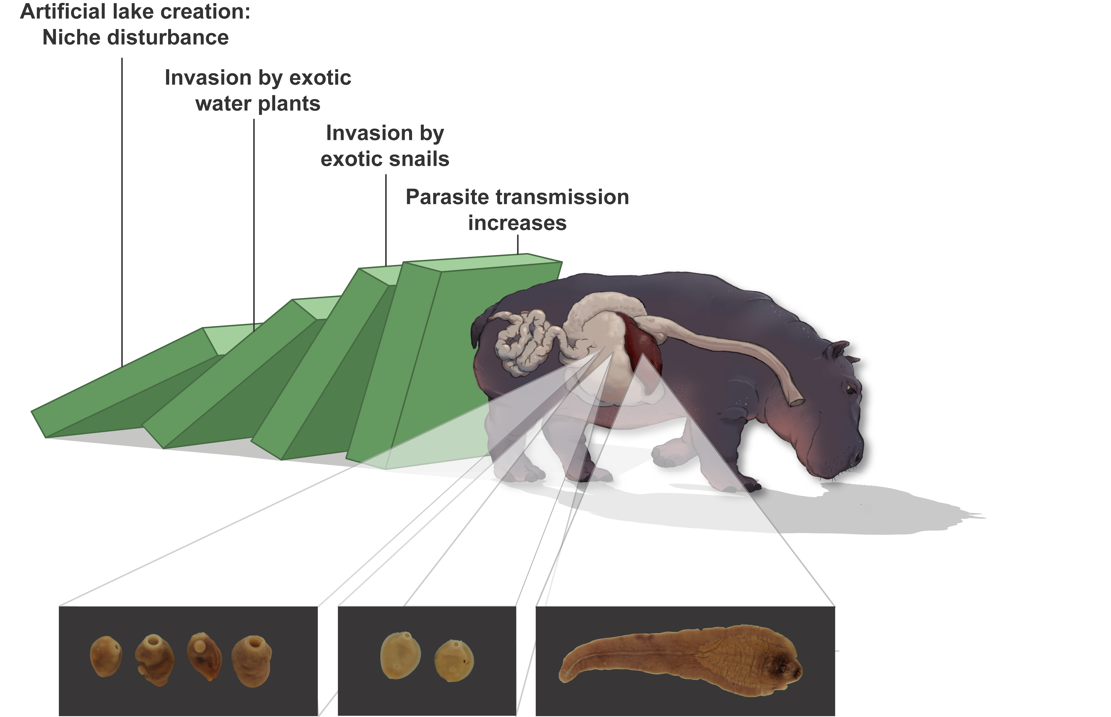
Invasive snails drive parasitic diseases of hippos in artificial lakes of Zimbabwe
Schols, Carolus et al., 2021
BMC Biology

Slide 5
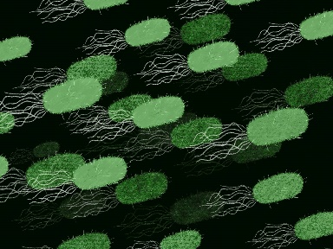
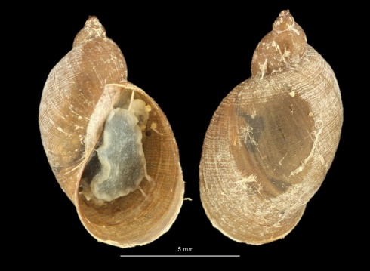
Investigate why this snail is so compatible
Microbiome
Fasciola nyanzae
Compare their microbiome to:
Co-occurring snails
A resistant P. columella population in South America
Pseudosuccinea columella

Slide 6
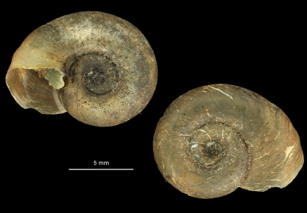
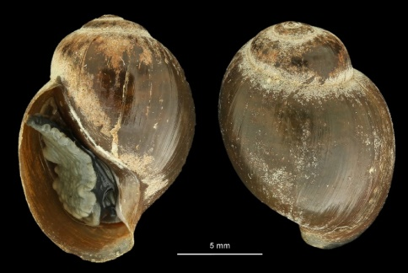
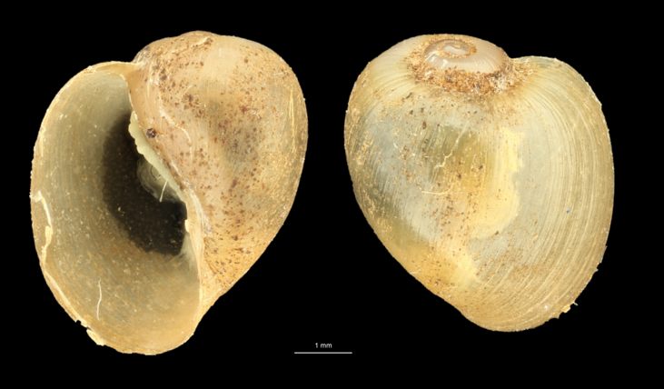
TRISS - Towards a better understanding of the tripartite interactions driving Schistosoma transmission in Senegal
Investigate whether the diminution of prevalence of intestinal schistosomiasis in the SRB is linked to interactions between S. mansoni and other parasite species within B. pfeifferi.
Characterize the microbiome and trematode communities of B. truncatus and B. globosus sampled along the SRB.

Slide 7
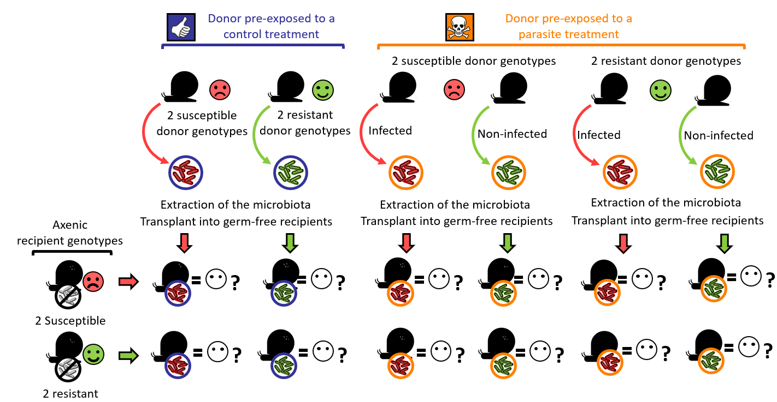
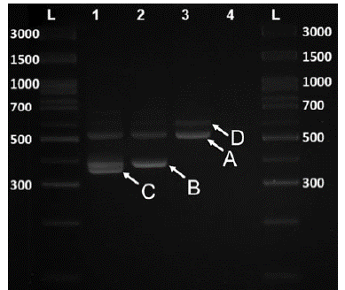
Methodology
HTAS – snail and trematode
16S metabarcoding – bacteria
Transplant experiment
Hammoud et al., 2021
20 per replicate
X 3 replicates
Schols et al., 2019

Slide 8
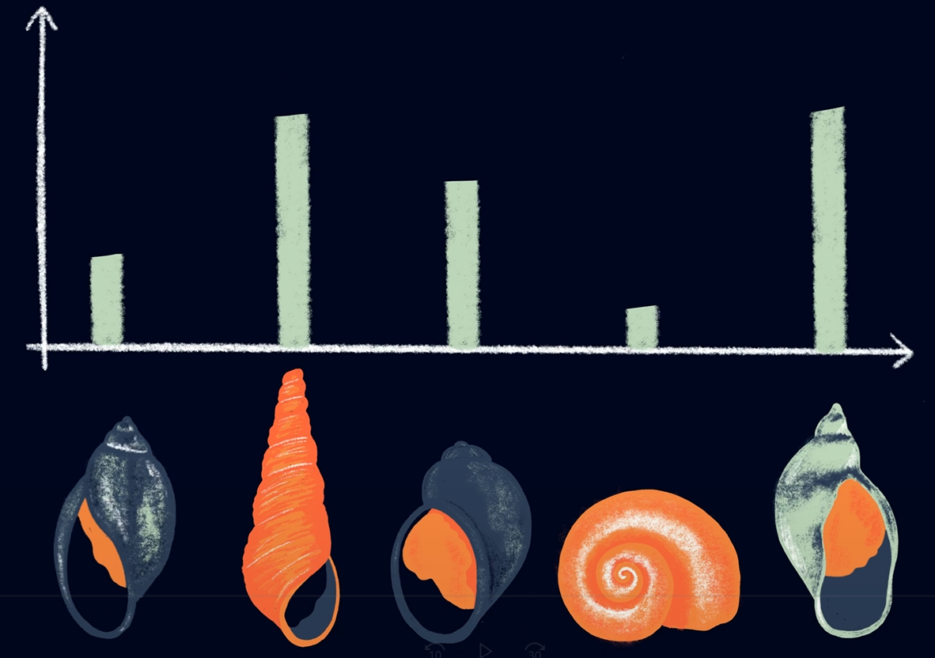
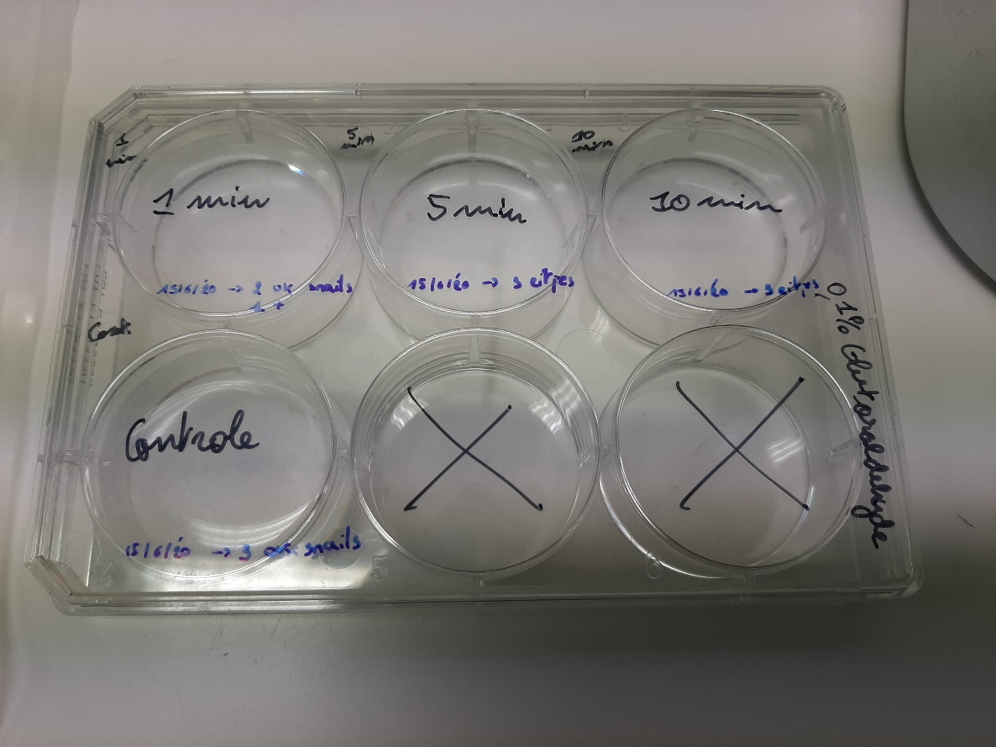
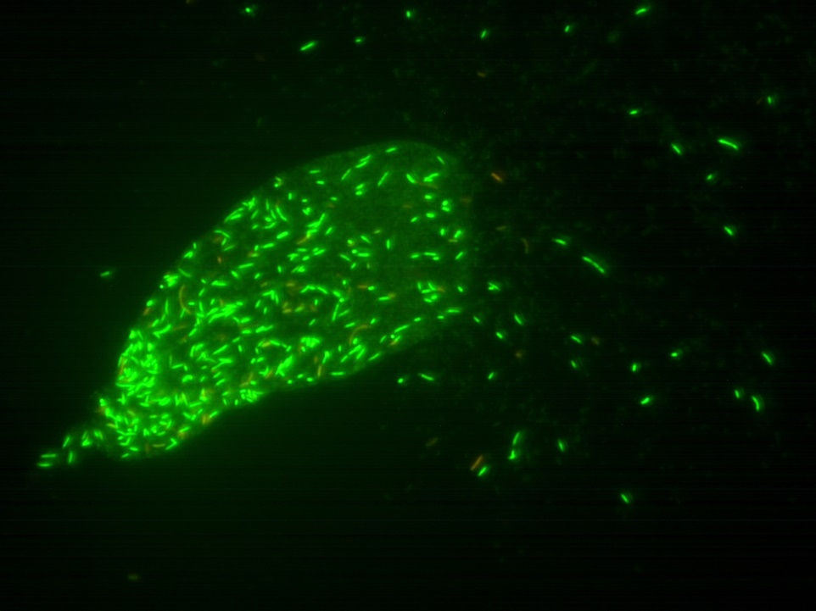
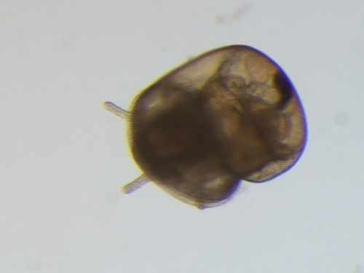
Preliminary data
Obtaining axenic snails: (SYTO 9 life/death staining)
Extreme treatment as control
Serial staining to better understand what happens
Other suggestions?

Slide 9
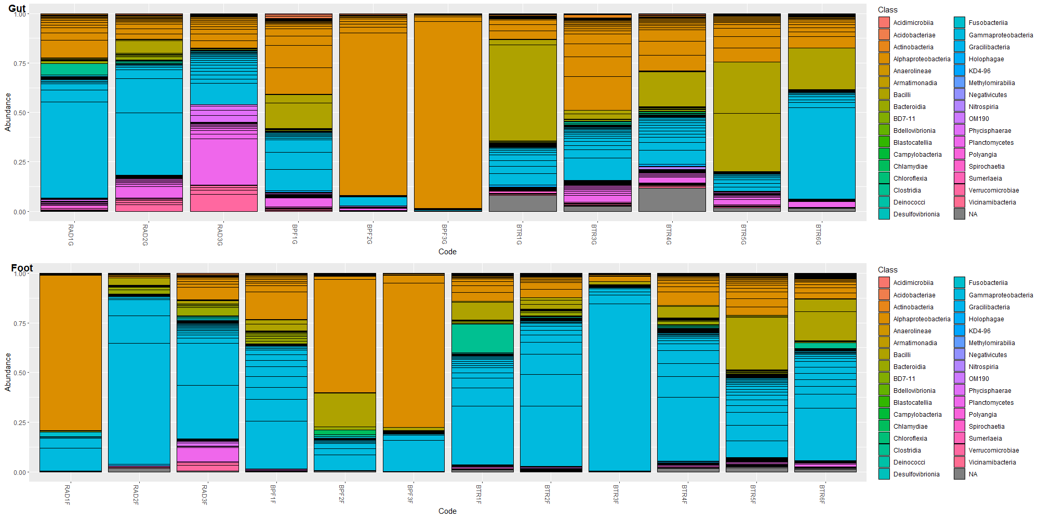
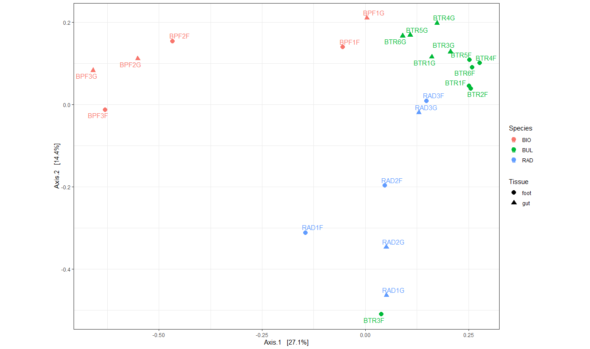
Preliminary data
Optimized PCR protocol and sequencing results look good
MiSeq V3 600 -> lots of reads lost
Microbiome pipeline. Struggling with errors

Slide 10
Discussion
Axenic experiment
Further tips on things to try
DESeq2 issue
Numeric to integer
Notes:
Joint species contribution modelling

